Slide 1


Student Dropout Prediction
Predicting and Preventing Student Dropouts Efficiently
G.MAHATHI – 2320090024
Y.SRI VATSAV – 2320030112
M.SREE VATHSAV – 2320030078
A.RAHUL – 2320030479

Slide 2

The Importance of Early Prediction
Student retention is a critical challenge facing higher education institutions worldwide. Early identification of at-risk students enables timely interventions that can dramatically improve outcomes.
By leveraging data science and machine learning, institutions can move from reactive to proactive support, reducing dropout rates whilst enhancing student success and institutional performance.

Slide 3
Understanding the Dropout Problem
Academic Challenges
Financial Pressure
Poor grades, course failures, and difficulty adapting to university-level work
Economic hardship, student debt, and competing work commitments
Social Factors
Wellbeing Issues
Lack of community, isolation, and difficulty integrating into campus life
Mental health struggles, stress, and inadequate support systems
Dropouts impact not only individual students but also institutional funding, reputation, and broader societal goals around educational attainment.

Slide 4
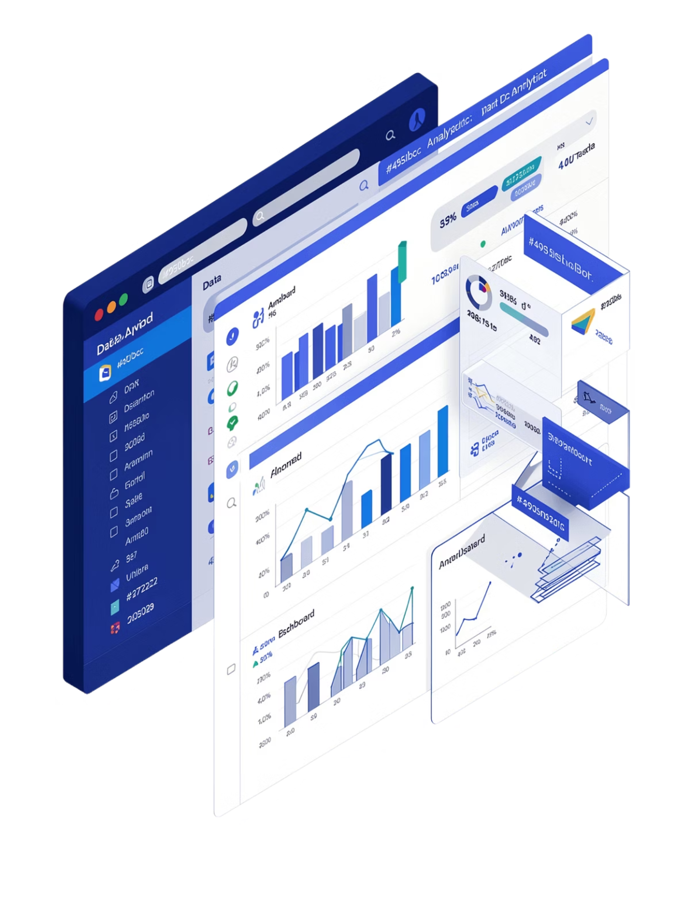
Data Collection Framework
01
Academic Records
Grades, course completion rates, GPA trends, and academic history
02
Attendance Data
Class participation, lecture attendance, and engagement metrics
03
Socio-economic Background
Demographic information, financial aid status, and family circumstances
04
Behavioral Indicators
Library usage, online platform activity, and extracurricular involvement

Slide 5
Machine Learning Models for Prediction
Decision Trees
Neural Networks
Tree-based models that split data based on feature values, creating interpretable rules for classification. Excellent for understanding key factors.
Deep learning architectures that identify complex patterns through layered processing. Capture non-linear relationships between variables.
Support Vector Machines
Ensemble Methods
Powerful classifiers that find optimal boundaries between classes, effective for high-dimensional data with clear separation patterns.
Combining multiple models (Random Forest, Gradient Boosting) to improve accuracy and robustness through collective intelligence.

Slide 6





Key Predictive Factors
Attendance & Participation
Academic Performance
Class presence, assignment submission, and engagement levels
GPA, course grades, and academic progression patterns
Engagement Metrics
Campus activities, peer interactions, and community involvement
Psychological Indicators
Wellbeing assessments, stress levels, and mental health screenings
Socio-economic Factors
Financial status, work commitments, and family support systems

Slide 7





System Architecture and Workflow
Collect Data
Process Data
Train Model
Predict & Alert
Data Collection
Data Processing
Gather comprehensive student data from institutional systems
Clean, normalize, and transform data for analysis
Model Training
Early Alerts
Train ML algorithms on historical dropout patterns
Generate risk scores and intervention recommendations

Slide 8
Intervention Strategies and Support Systems
1
2
3
Early Identification
Personalized Mentoring
Academic Support
Screen students regularly using predictive scores to flag those requiring attention
Assign dedicated mentors to guide academic planning and career development
Provide tutoring, study skills workshops, and subject-specific assistance
4
5
Counselling Services
Continuous Monitoring
Offer mental health support, financial advice, and wellbeing resources
Track progress through dashboards and adjust interventions as needed

Slide 9





Stakeholder Collaboration
Parents & Families
Academic Staff
Partner in student support and wellbeing monitoring
Identify concerns and provide course-specific support
Administrators
Coordinate resources and policy implementation
Peer Networks
Build community and peer mentoring programmes
Counsellors
Deliver psychological and academic guidance
Successful dropout prevention requires coordinated efforts across all stakeholders, with clear communication channels and shared accountability for student success.

Slide 10


Conclusion: The Path Forward
Key Insights
Machine learning enables early, accurate identification of at-risk students
Comprehensive data collection improves prediction reliability
Personalized interventions significantly reduce dropout rates
Ongoing monitoring ensures sustained student engagement
Future Directions
Integration of real-time analytics, expanded predictive features including wellbeing metrics, and automated intervention systems will further enhance retention efforts.
Combining data science with human-centered support systems creates the most effective approach to student retention and success.

